Slide 1
PSAS
Rocket Ready Schematic
Original Circuit By: Andrew Greenberg
Created By: Richard Witherspoon
Created On: May 28th, 2012
Updated By: Richard Witherspoon
Updated On: May 30th, 2012

Slide 2
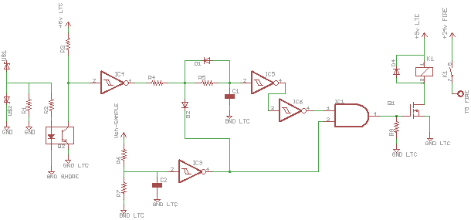
Why is R4 there? If its limiting current back to the logic gate why not use a diode?
What is D2 doing and why junctioned to the output of IC9? Diode appears to limit flow into upper circuit but this also appears to allow a logic HIGH from IC4 to go through to IC1 AND-gate.
Diode keeps voltage spike at “shut-off” from rippling back into logic circuit.
Dual invert gates have Schmitt triggers (resultant logic state is the same and cheaper than Schmitt trigger on AND gate)
Resistor & Capacitor make timing circuit. Diode discharges capacitor
Resistor pulls N-MOSFET to ground for a known state (not floating)
Voltage limiting resistor (keeps from high-voltage burnout on short)
Bypass capacitor smoothes out ripples in signal (keeps gate from mis-triggering)

Slide 3
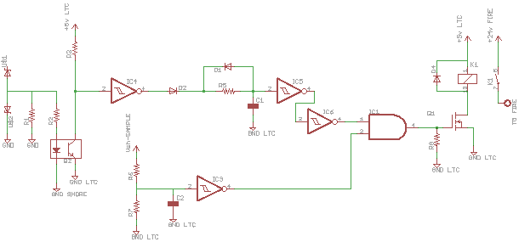
MODIFIED CIRCUIT
Flip this diode. This circuit is designed so that a high connects upper to 5v and pulls high. If below 0v – needs to ground out so it holds at 0 volts.
Move all of this to after the AND gate. Keep the double invertors to stop power ramping up on the MOSFET resulting in a slow relay trigger.
Voltage divider between these two resistors to drop 19v to never above 5v
Inverter Schmitt Buffer
CD74HC14M96
Digikey
(IC with 6 invertors)

